Slide 1
BIOLÓGIA és BIOTECHNOLÓGIA
6. rész
Előadó: Ballagi András, c. egyetemi tanár
Richter Gedeon NyRt. - BME
Írásos segédanyag található a:
http://oktatas.ch.bme.hu
    /oktatas /konyvek /mezgaz
    /Biol-biotech-vegyész-MSc címen

Slide 2
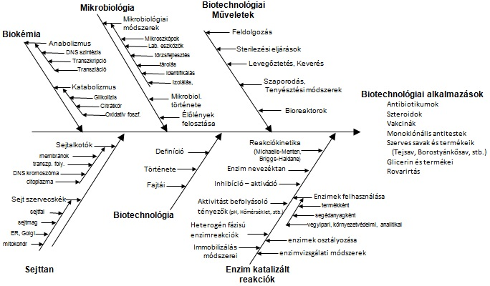
A tananyag szerkezete:
2
Notes:
2

Slide 3
Antibiotics
Antibiotics can be selectively toxic by targeting such features as the bacterial cell wall, 70S ribosomes, and enzymes that are specific to bacteria.
In this way the human eukaryotic cells are unaffected.
For example: penicillin, ampicillin, amoxycillin, methicillin
Inhibits enzymes involved in synthesis of peptidoglycan
for bacterial cell wall, causing cell lysis.
Bacteriocidal
Narrow spectrum- little effect on Gram negative cells.
Other antibiotics may affect:
  Cell membrane
  DNA replication
  Transcription
  Translation

Slide 4
Antibiotic production
There are over 10 000 different antibiotics known, but only about 200 in commercial use, since most new antibiotics are no better than existing ones.
Finding a new antibiotic and getting it on to the market is a very long process and can take 15 years.
Antibiotics are produced on an industrial scale using a variety of fungi and bacteria.

Slide 5
Penicillin production
Penicillin is produced by the fungus Penicillium chrysogenum which requires lactose, other sugars, and a source of nitrogen (in this case a yeast extract) in the medium to grow well.
Like all antibiotics, penicillin is a secondary metabolite, so is only produced in the stationary phase.
It requires a STR fermenter, and a fed batch process is normally used to prolong the stationary period and so increase production.

Slide 6
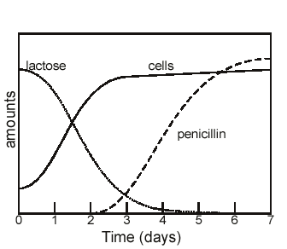
Penicillin production in stationary phase

Slide 7
Penicillin production
When penicillin was first made at the end of the second world war using the fungus Penicilium notatum, the process made 1 mg dm⁻³.
Today, using a different species (P. chrysogenum) and a better extraction procedures the yield is 50 g dm⁻³.
There is a constant search to improve the yield.

Slide 8
Penicillin production
Downstream processing is relatively easy since penicillin is secreted into the medium (to kill other cells), so there is no need to break open the fungal cells.
However, the product needs to be very pure, since it being used as a therapeutic medical drug, so it is dissolved and then precipitated as a potassium salt to separate it from other substances in the medium.

Slide 9
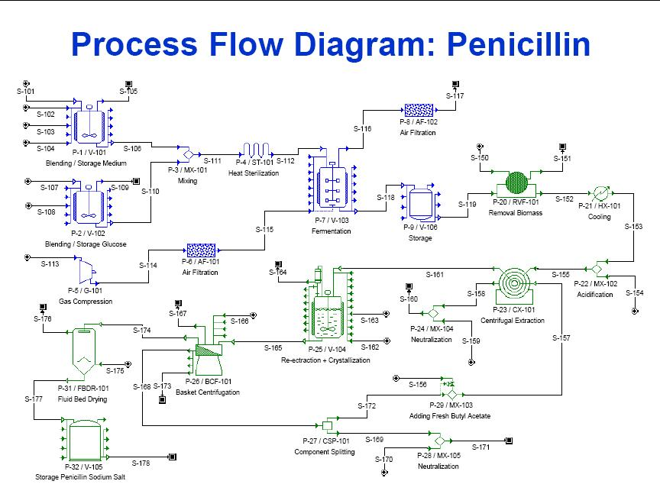
Penicillin production – process flow diagram

Slide 10
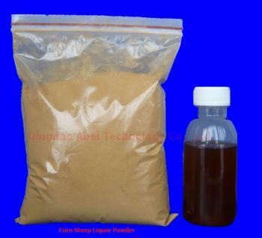
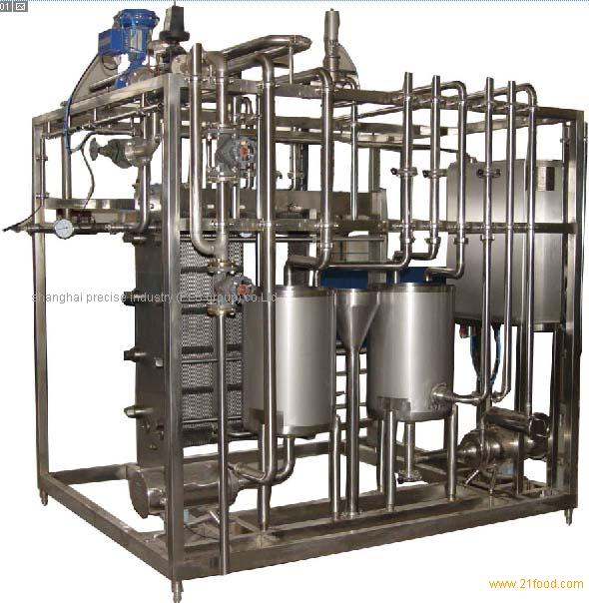
Penicillin production
In the case of the Penicillium fungus, the medium usually contain its carbon source which is found in corn steep liquor and glucose.
Medium also consist of salts such as Magnesium sulphate, Potassium phosphate and Sodium nitrates. They provide the essential ions required for the fungus metabolic activity.
Heat sterilisation
Medium is sterilse at high heat and high pressure.The pressurized steam is use usually and the medium is heated to 121oC.
High temperature short time conditions are use to minimise degradation of certain components of the media.

Slide 11
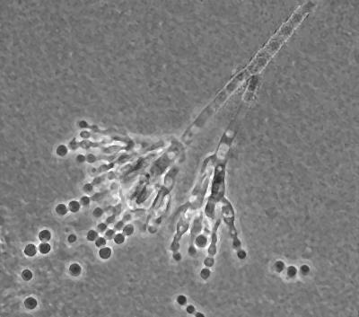
Penicillin production
Like any other scale up process, usually the seed culture is developed first in the lab by the addition of Penicillium spores into a liquid medium.
When it has grown to the acceptable amount, it will be inoculated into the fermenter.
In some cases,the spores are directly inoculated into the fermenter.

Slide 12
Penicillin production – process flow diagram

Slide 13
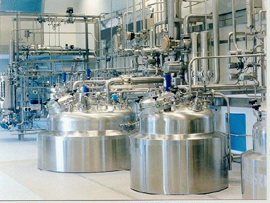
Penicillin production
Fermentation for penicillin is usually done in the fed-batch mode as glucose must not be added in high amounts at the beginning of growth which will result in low yield of penicillin production as excessive glucose inhibit penicillin production.
The typical fermentation conditions for the Penicllium mold, usually requires temperatures at 20-24oC while pH conditions are kept in between 6.0 to 6.5.
The impeller is necessary to mix the culture evenly throughout the culture medium, fungal cells are much hardy and they are able to handle rotation speed of around 200rpm.

Slide 14
Penicillin production – process flow diagram

Slide 15
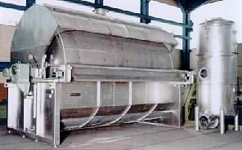
Penicillin production
Filtration is necessary to remove the biomass from the culture such as the fungus and other impurities away from the medium which contains the penicillin product.
The Rotary vacuum filter is commonly employed as it able to run in continuous mode in any large scale operations.
Non-oxidising acid such as phosphoric acid are introduced in order to prevent loss of activity of penicillin, the pH of the extraction should be maintained at 6.0-6.5.

Slide 16
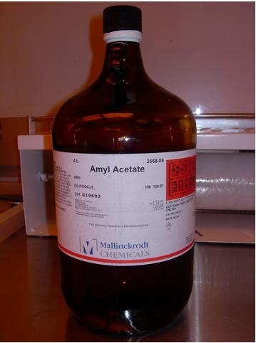
Penicillin production
In order to dissolve the penicillin present in the filtrate, organic solvents such as amyl acetate or butyl acetate are use as they dissolve penicillin much better than water at physiological pH.
At this point, penicillin is present in the solution and any other solids will be considered as waste.

Slide 17
Penicillin production – process flow diagram

Slide 18
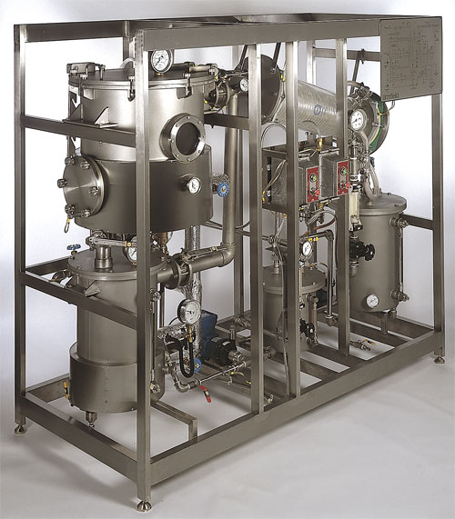
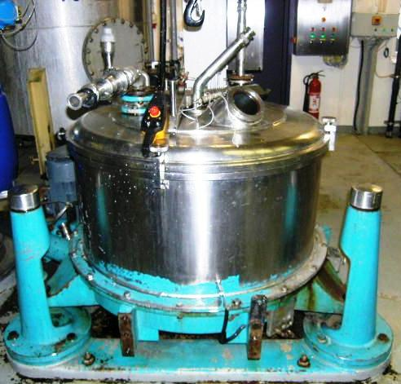
Penicillin production
Penicillin dissolve in the solvent will now undergo a series of extraction process to obtain better purity of the penicillin product.
The acetate solution is first mixed with a phosphate buffer, followed by a chloroform solution, and mixed again with a phosphate buffer and finally in an ether solution.
Penicillin is present in high concentration in the ether solution and it will be mixed with a solution of sodium bicarbonate to obtain the penicillin-sodium salt, which allow penicillin to be stored in a stable powder form at room temperature. The penicillin-sodium salt is obtained from the liquid material by basket centrifugation, in which solids are easily removed.

Slide 19
Penicillin production – process flow diagram

Slide 20
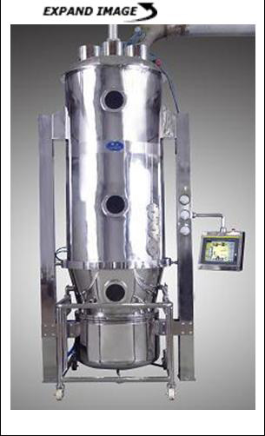
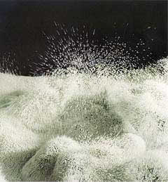
Penicillin production
Drying is necessary to remove any remaining moisture present in the powdered penicillin salt.
In fluid bed drying, hot gas is pump in from the base of the chamber containing the powdered salt inside a vacuum chamber.
Moisture is then remove in this manner and this result in a much drier form of penicillin.

Slide 21
Penicillin production – process flow diagram

Slide 22

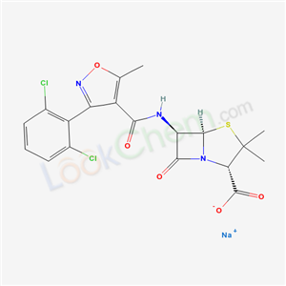
Penicillin production
Penicillin salt is stored in containers and kept in a dried environment.
It will then be polished and package into various types of products such as liquid penicillin or penicillin in pills.
Dosage of the particular penicillin is determined by clinical trials that are done on this drug.
The White Penicillin-Sodium salt

Slide 23
Modification of Penicillin
The resulting penicillin (called penicillin G) can be chemically and enzymatically modified to make a variety of penicillins with slightly different properties.
These semi-synthetic penicillins include penicillin V, penicillin O, ampicillin and amoxycillin.

